Slide 1
Superstore
Sales & Profit Analysis

Slide 2

Sales and Profit Analysis of Sample Superstore
Following is the analysis of the Sample Superstore data.
It includes geographical and yearly distribution of Sales.
For in-depth analysis segment and categories have been used to identify performances.
The visualizations will help in isolating challenges related to regional sales and profit in a superstore company.
Notes:
I’m analyzing Sample superstore dataset. My objective is to do Sales and profit Analysis to determine, Segment and category wise regional performances that will help to derive areas of improvement and resource management for a superstore company.

Slide 3
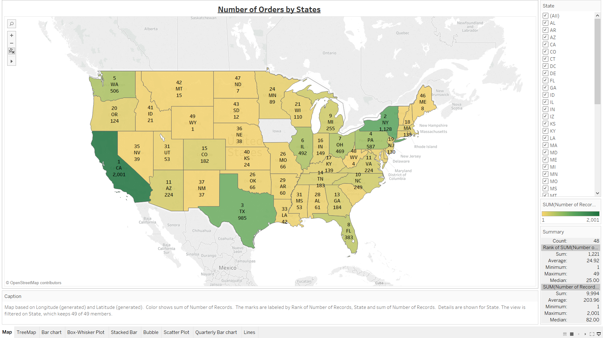
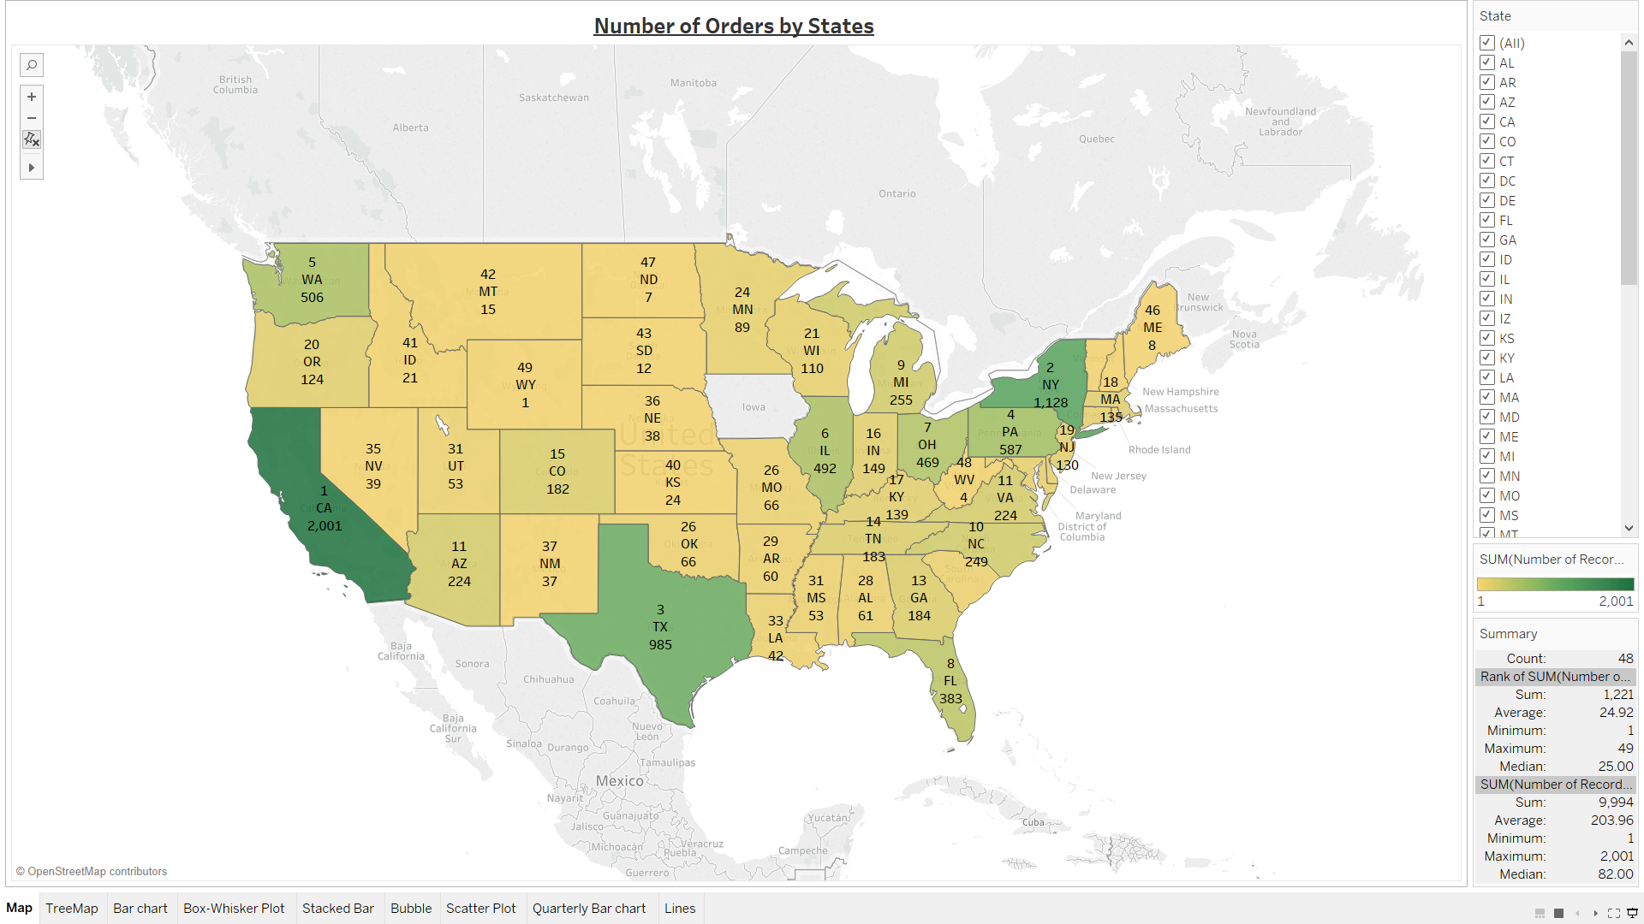
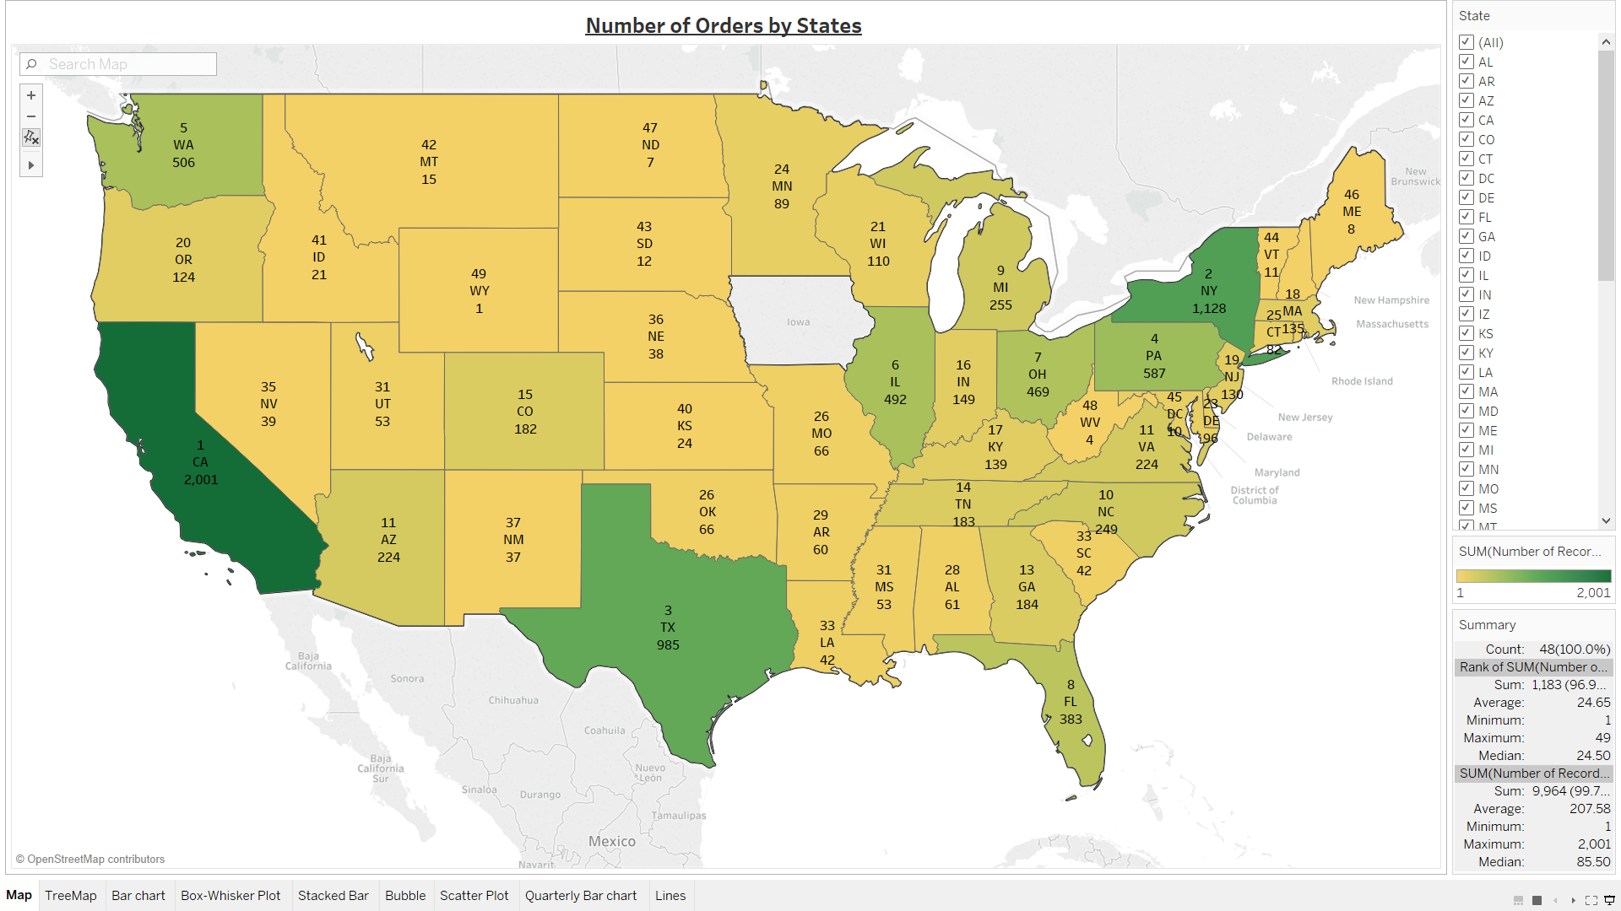
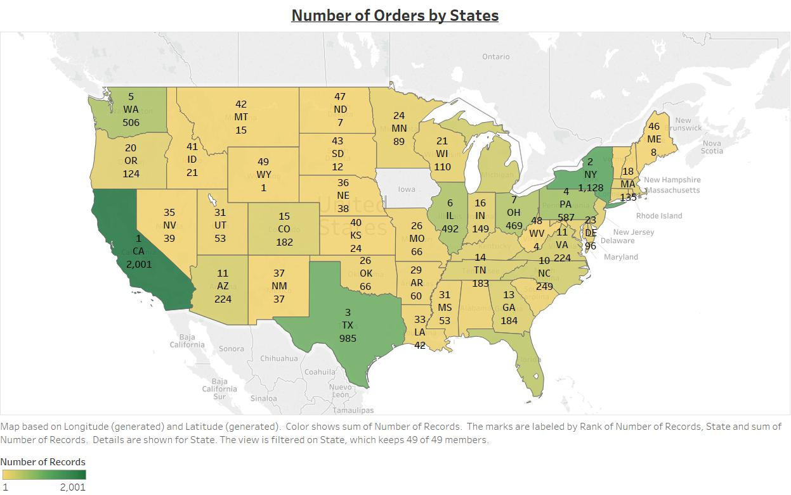
Title and Content Layout with Chart
Notes:
1. First question arises after looking at the dataset is -- what are the total orders by states. So, I started with State and number of records on a map setting and ranked them by total number of records. As we see, California is at topmost with 2001 sales orders, then comes 2. New York, 3. Texas and others.

Slide 4
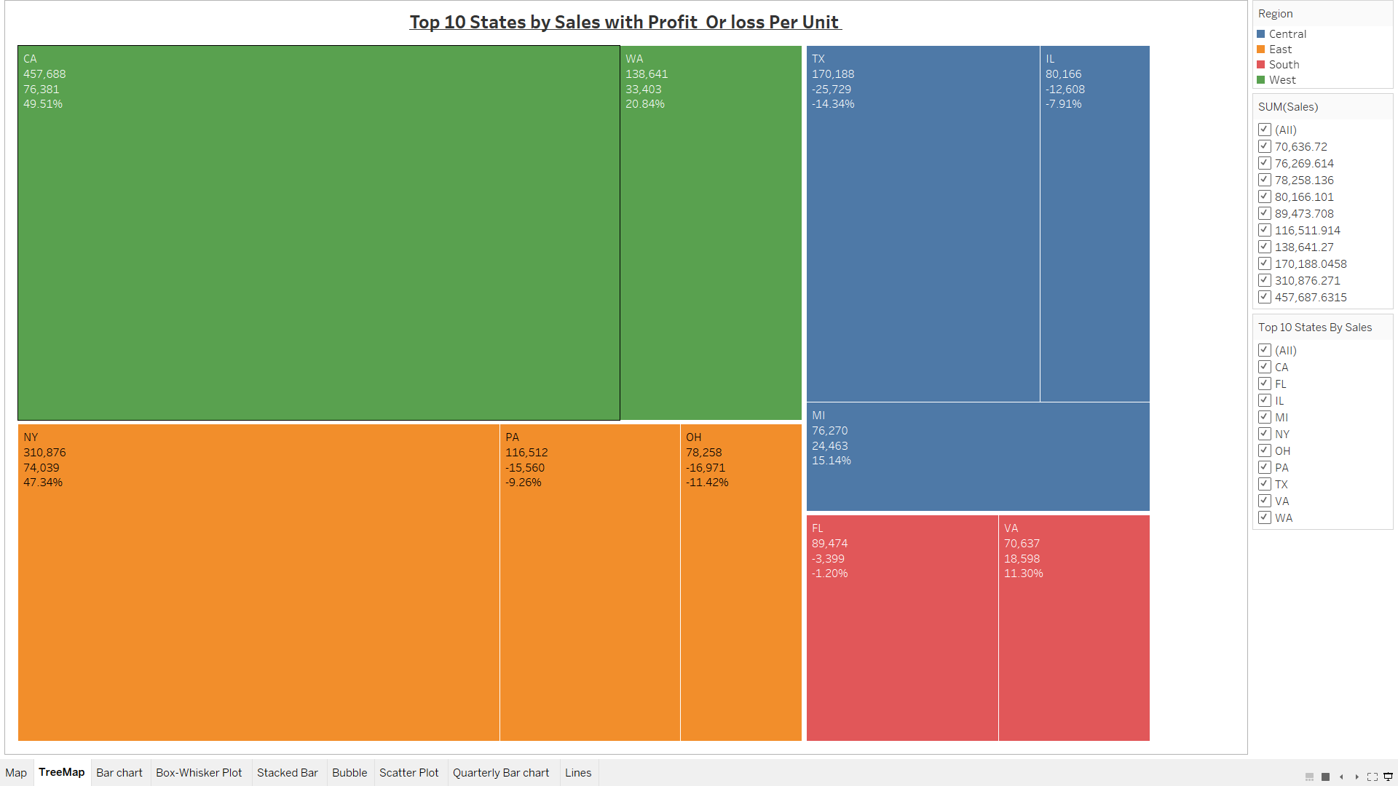

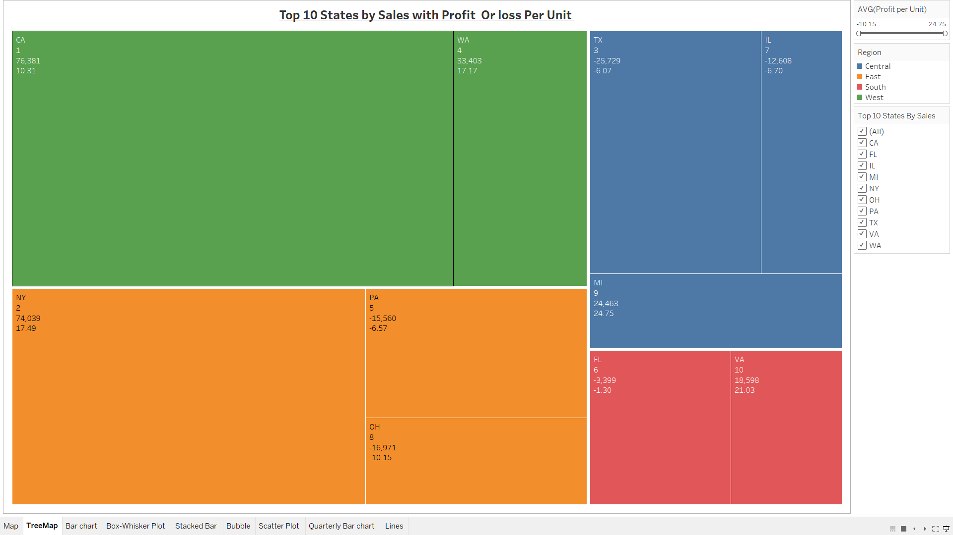
Notes:
2. Here, we have top ten states ranked by sales, total profit and profit per unit. As per the visual, Texas, Illinois, Philadelphia, Ohio and Florida are facing loss. Though Texas is 3rd by sales, they’re having a loss of $25,729 , so more effort needs to be put into Texas’s performance.

Slide 5
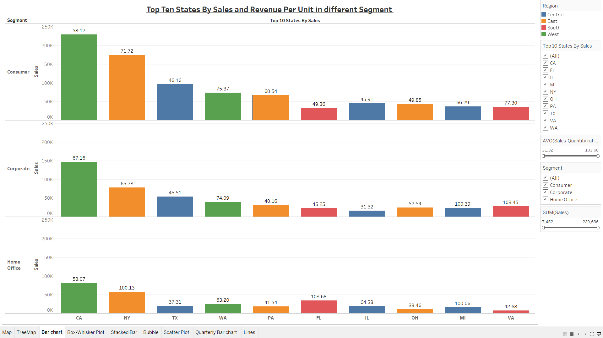
Notes:
3. Next comes, how the top ten states by sales are doing in different segment in their respective regions. As we can see, in general, most sales revenue is coming from the consumer segment except for Florida. We can also see, few states have more revenue from consumer sales but revenue generated per unit is more from corporate sales.

Slide 6
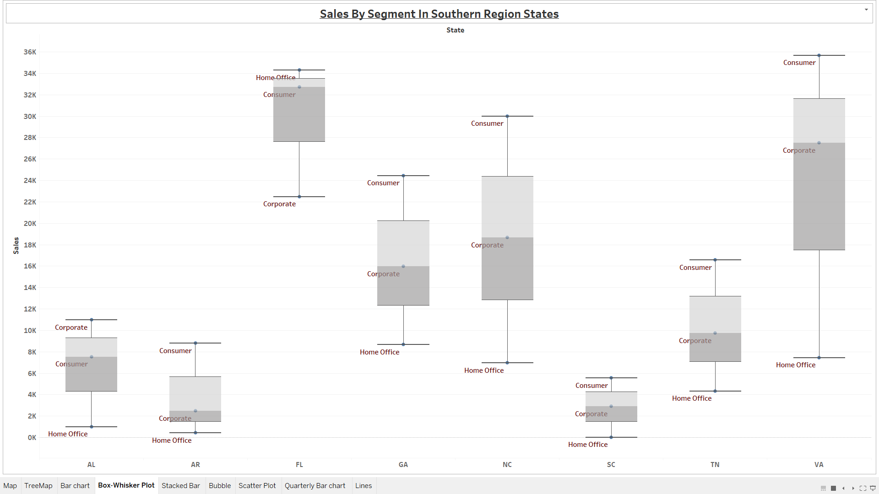
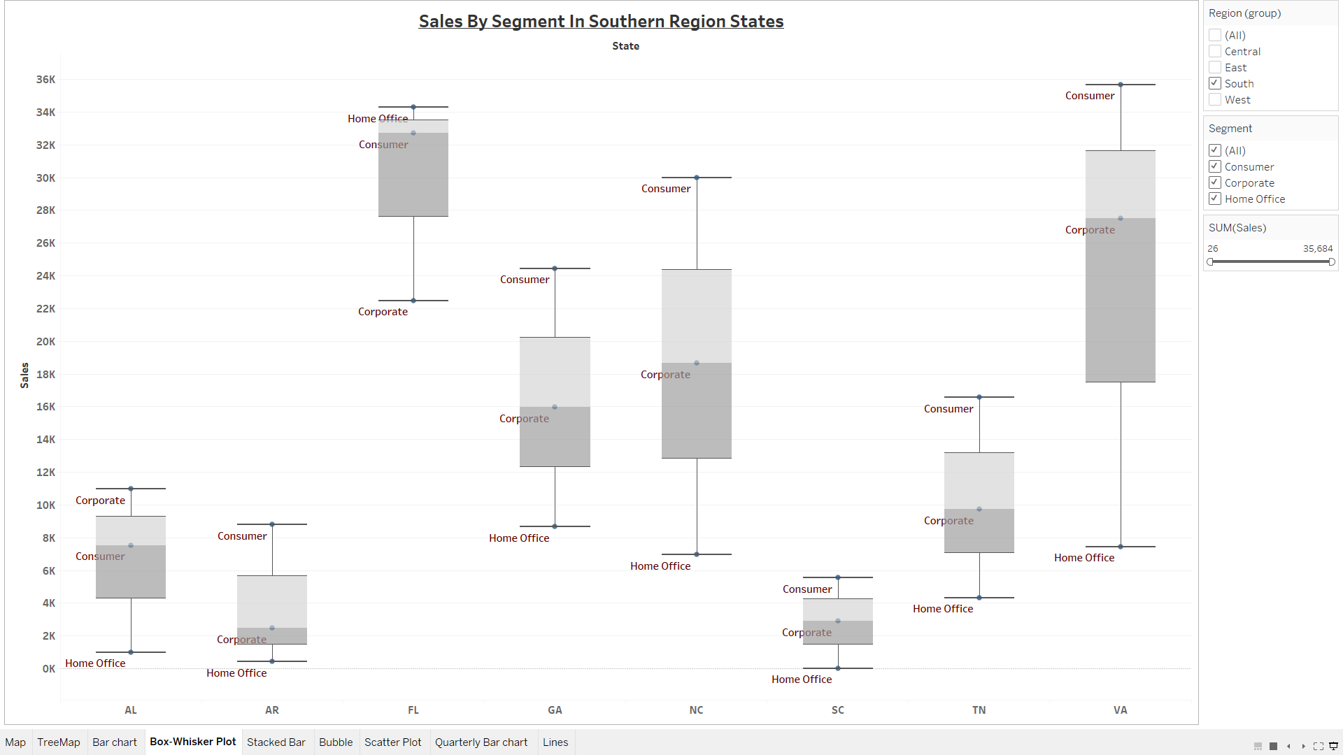
Notes:
4. This visualization is telling us about sales in different segment in the southern region states. Here, I found that Consumer Segment is mostly on the upper whisker in Box-whisker setting. In other words, Consumer segment is almost doing more than 50% of the business in the country.

Slide 7
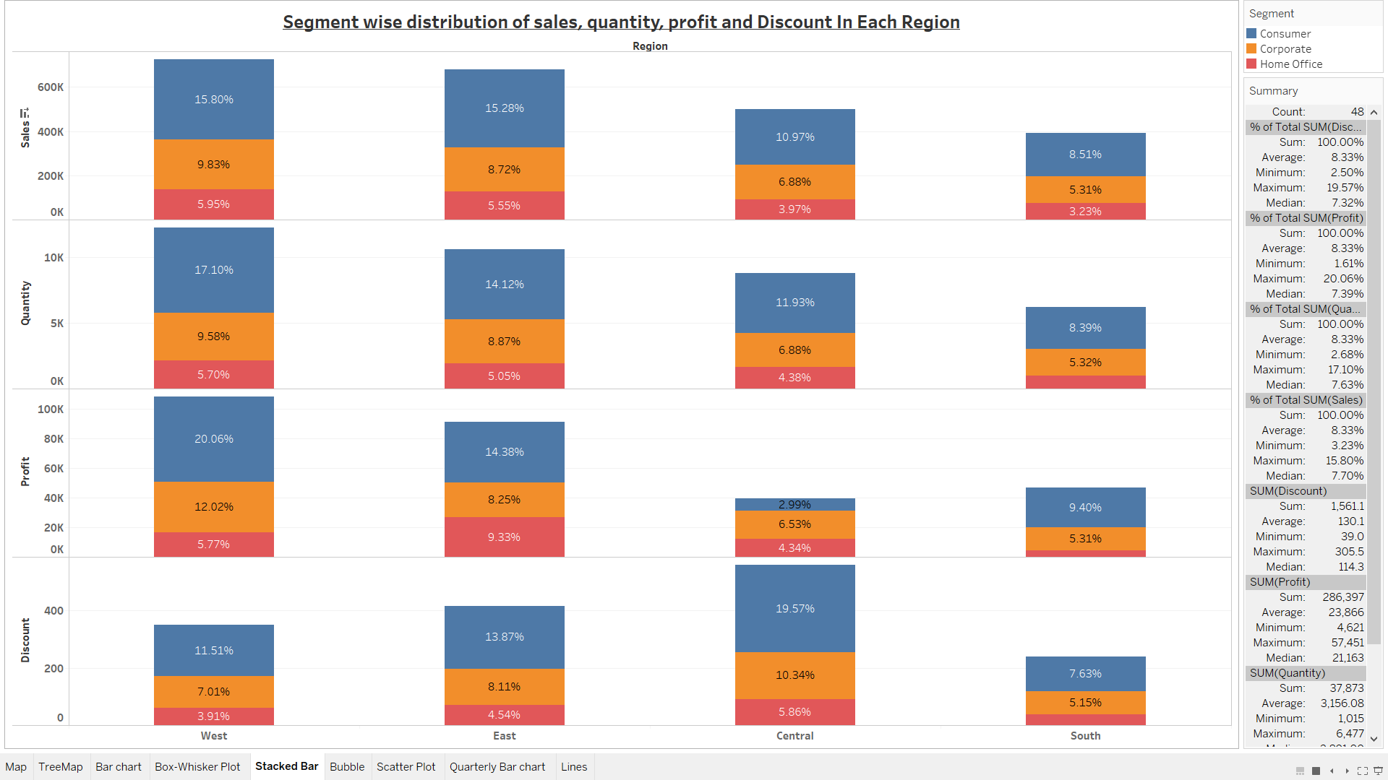
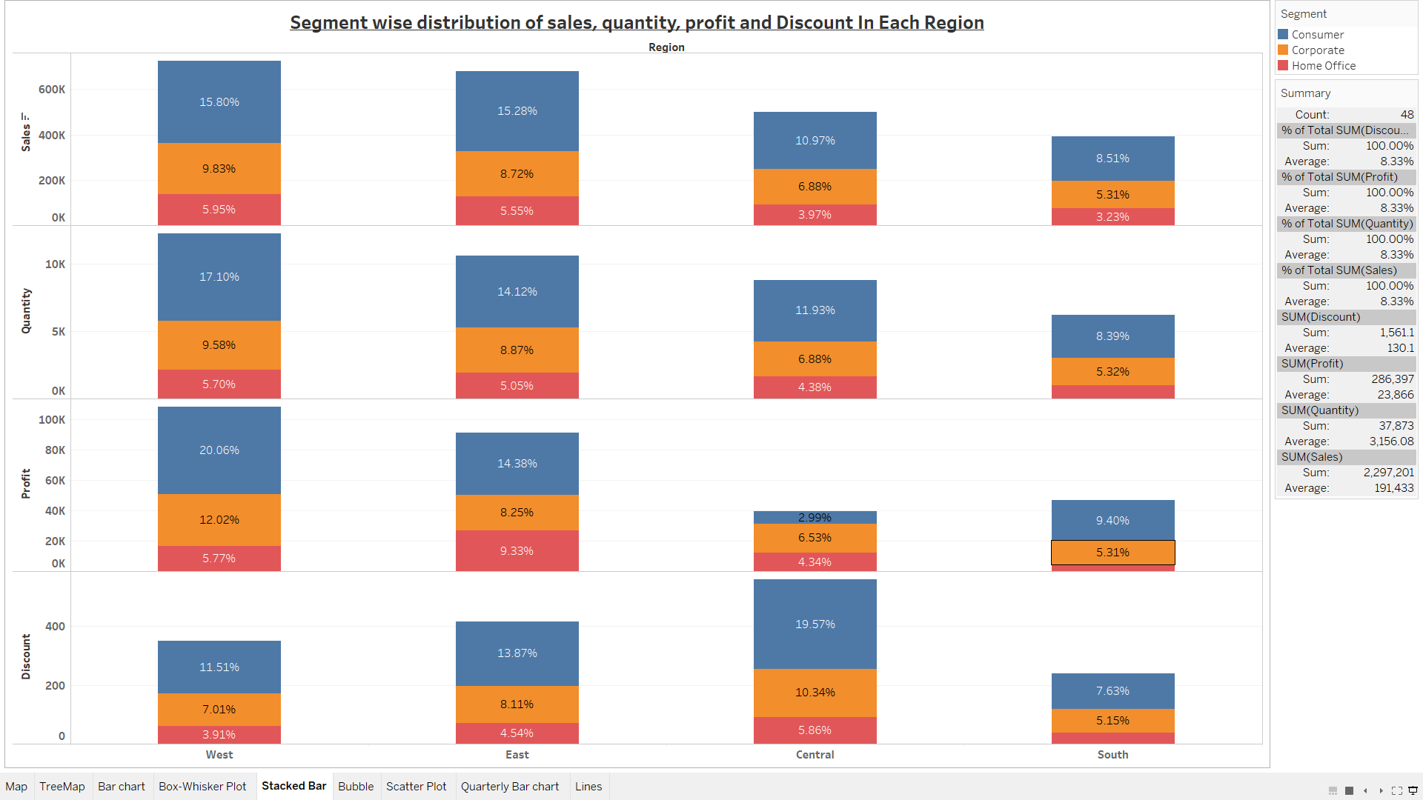
Notes:
5. To get a broader picture, let’s see segment wise distribution of Sales, quantity, profit and Discount in each region. As stacked bar is speaking for itself, Consumer segment is flourishing in all four measures in four regions with an exception of Profit measure in the Central region.

Slide 8
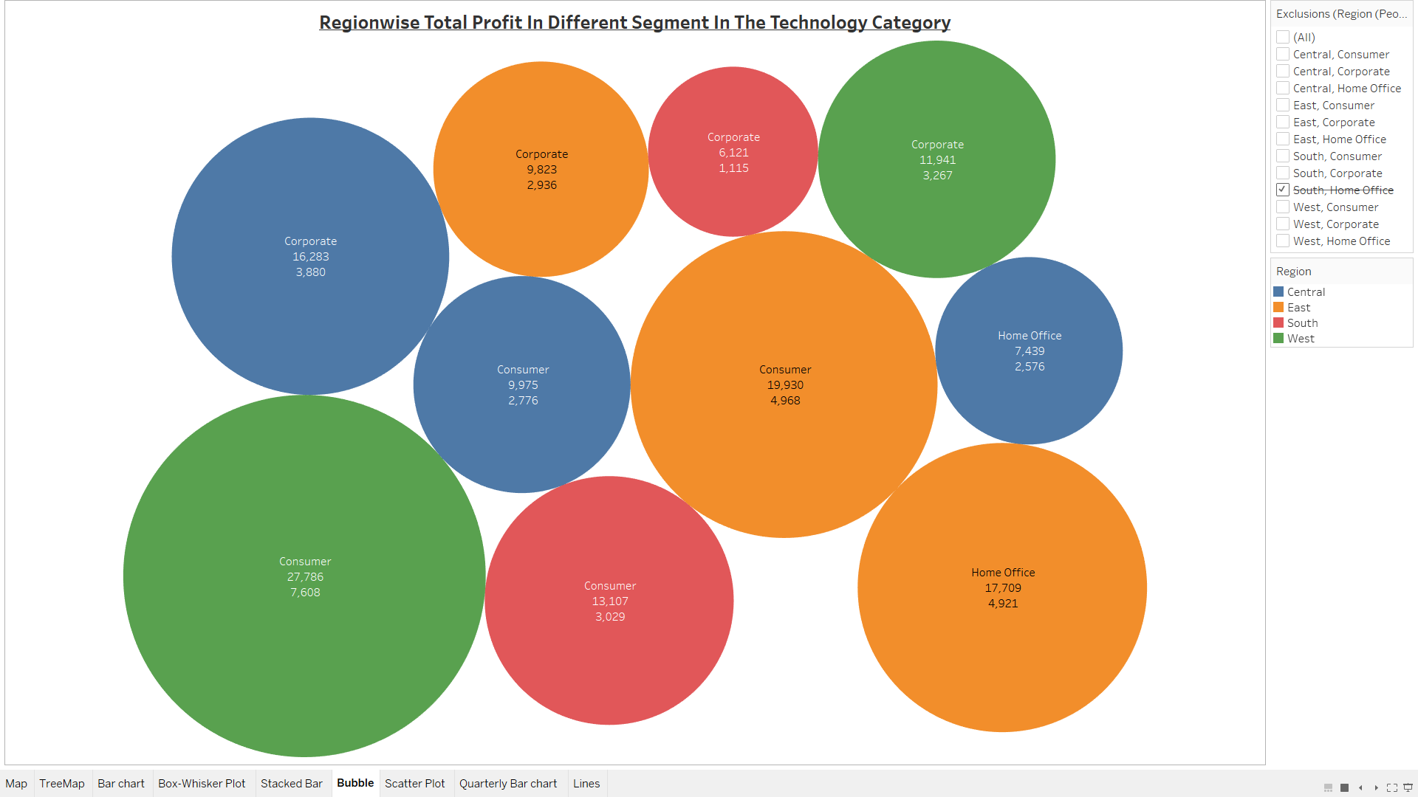


Notes:
6. Now let’s consider region wise profits in the technology category, here we see again that consumer segment is 1st while corporate is making to 2nd position. So, category is not playing much role in changing the general observation that consumer is most profitable and other segments need more attention .

Slide 9
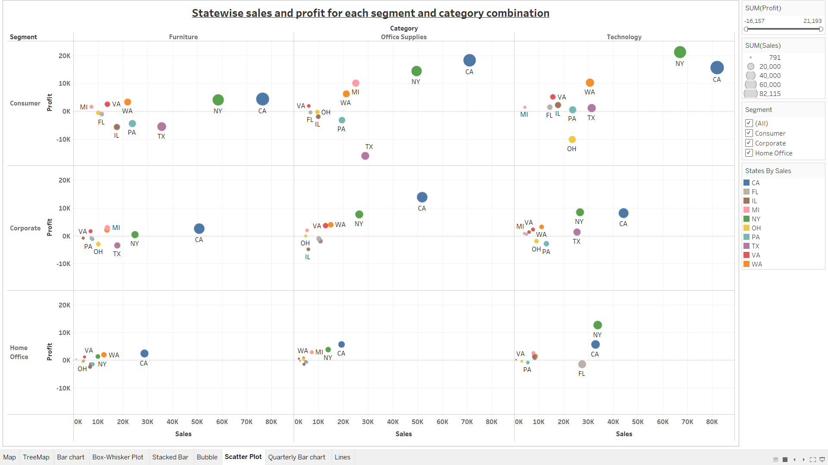
Notes:
7. Sales & Profit for each segment and category combination can be seen in this scatter plot. Here, the total sales are depicted by size of the circle and each color represents different states (also shown in the filter). We can infer from the visual that the office supplies sales for home office segment are very low for most states and an area to work on.

Slide 10
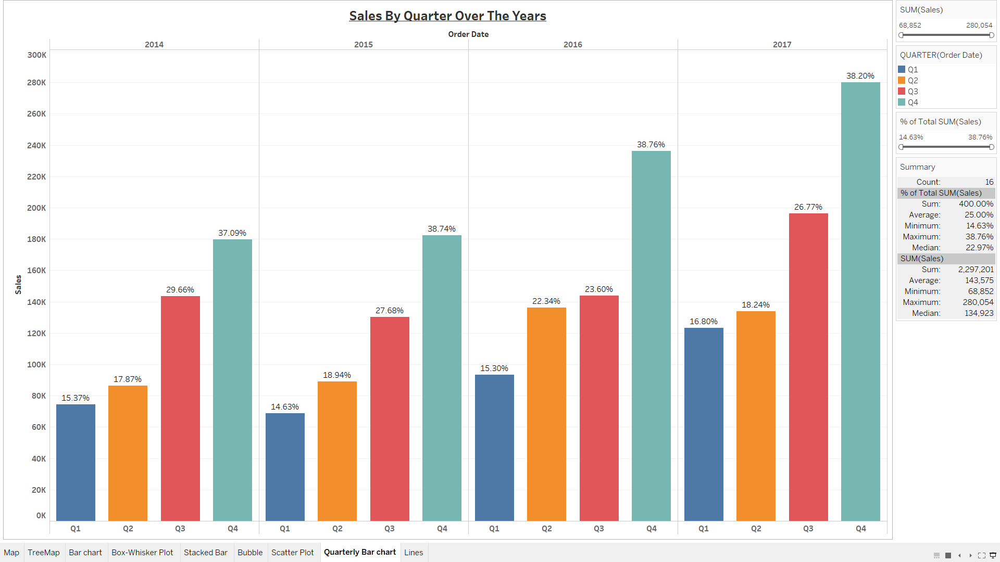
Notes:
8. This bar graph is showing quarterly sales over the years for all records throughout the country. We can see that the fourth quarter has the most sales every year, while on an average 38% of the yearly sales happens in the fourth quarter. As visible, least sales occur in the first quarter and that is something to focus on.

Slide 11
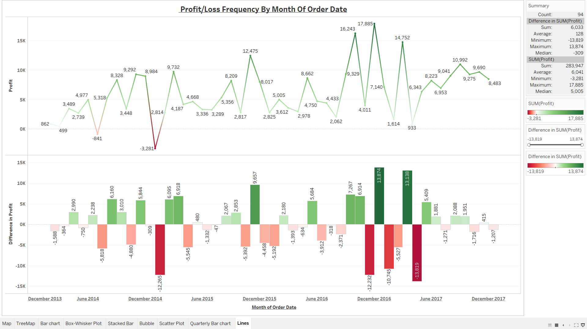
Notes:
9. Finally, Profit & Loss frequency is shown by month of order date. The profit isn’t steady and is varying hugely every month. So, the accounting processes need to be improved for better representation.

